Slide 1
EE 66 Lab
Welcome! We will begin at Berkeley Time.

Slide 2
Today’s Agenda
About Us
About Lab: Policies & Overview
Marimo Notebook
Python Bootcamp

Slide 3
About Us!

Slide 4
TA Name - Lab TA
Year, major
Fun
Facts
Interests
Pictures

Slide 5
UCS1 Name - Lab Assistant
Year, major
Fun
Facts
Interests
Pictures

Slide 6
About Lab!

Slide 7
Semester Outline
Shazam
Acoustic Positioning
Voice Recognition
Image Deconvolution
Intro to Medical Imaging
Python
Bootcamp

Slide 8
Policies
Labs this semester are in-person.
To receive credit, you must pass all autograder checks and then get checked off by a lab TA/UCS1 during your assigned lab section.
For Lab 0 Only:
You are free to complete the lab yourself on DataHub using your own computer.
You do not need to attend the full lab section. However, you must come to Cory 111 during your assigned lab section to get checked off.

Slide 9
Policies
In a checkoff, you will demonstrate your work from portions of the lab and answer conceptual questions related to the lab. You should aim to get checked off by the end of your lab section.
You may work with a partner and get checked off together.

Slide 10
Lab Grade
Number of Labs Missed | What happens?
0 | Full lab credit
1 | -10% of your lab grade
2 | -40% of your lab grade
3 | Automatic F

Slide 11
Buffer Labs
During buffer lab weeks, you may get checked off for only one missed lab that occurred since the previous buffer week.
No other labs can be checked off.
The eligible labs for makeup for each buffer lab period will be released in a timely manner. Please look out on Ed for each buffer lab signup.

Slide 12
Important Notes
No food or drink is allowed in the lab room! Please eat outside of the lab room.
When you are done with the lab:
Clean up your workspace
If using the lab computers:
Log out of your account
Turn off the display
Do not turn off the desktop
If you need any accommodations, please email ee66-lab@berkeley.edu

Slide 13
Bootcamp Time!

Slide 14
Marimo Notebook
A web-based interactive computational environment similar to Jupyter Notebook
Document containing a list of input/output cells
Can contain code, text, mathematics, plots and rich media
.py file extension
But what does this look like?

Slide 15
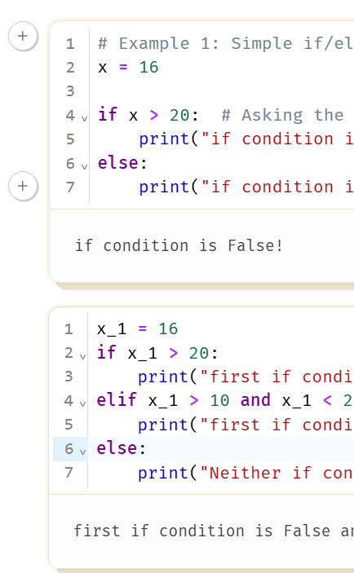
Marimo Notebook
Stateless list of input & output
The order you run these cells does not matter!
Control/Command + Enter to run current block
Shift + Enter to run and move forward

Slide 16
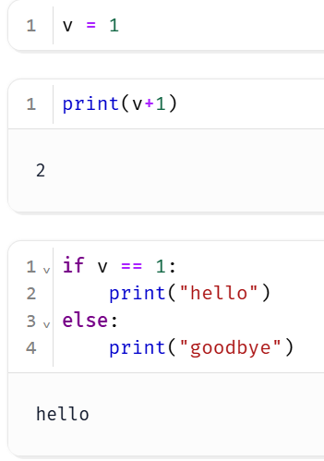
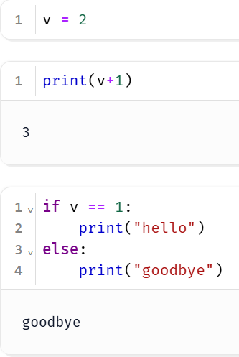
Marimo Notebook
Running / changing one cell executes downstream cells
If I change variable v, the next two cells are automatically affected

Slide 17
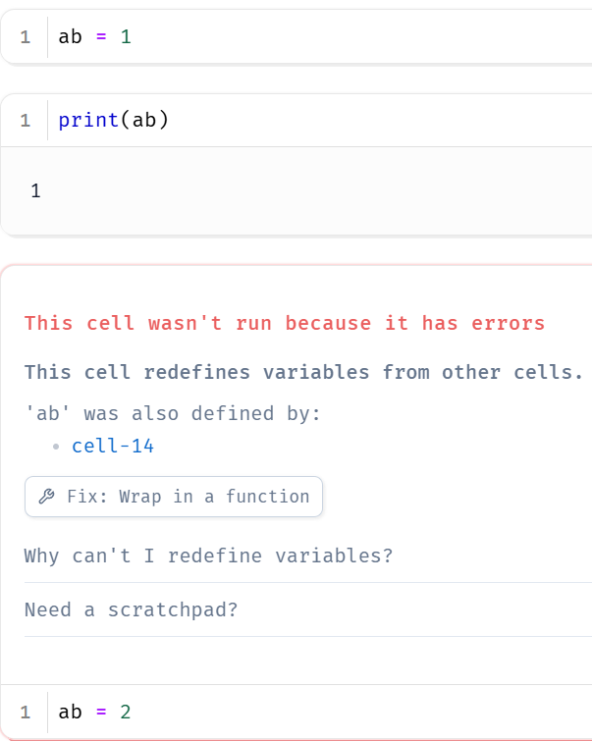
Marimo Notebook
Variable names for assignment can only happen in one cell.
You cannot define a variable in one cell and redefine it in another cell

Slide 18
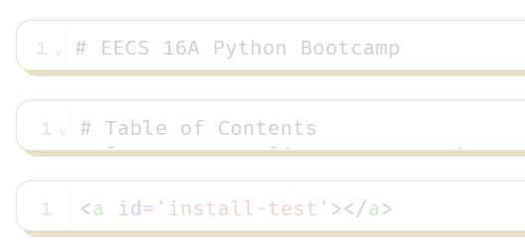
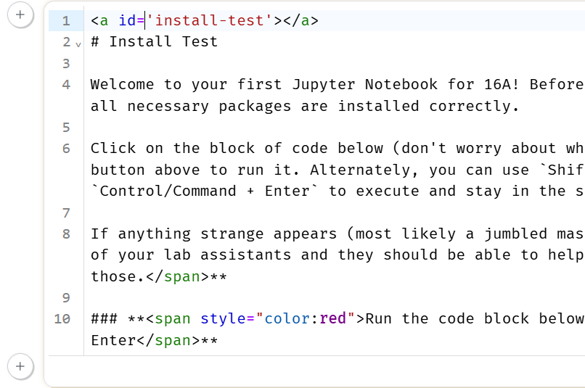
Marimo Notebook
Text/Markdown
Expand on the cell (simply click inside)
Control/Command + Enter to format current block
Shift + Enter to format current block and move forward

Slide 19
Running the Marimo Lab
If you are using the lab computer, login using your CalNet ID
Click on the Datahub link from the course website
You should see a .py file to start working on the lab!

Slide 20
Using the Lab Computers
Log in to the computers using your Calnet ID

Slide 21
Python Bootcamp
Review Python
List comprehension
Introduction to NumPy - scientific computing in Python
NumPy functions: np.linspace, np.eye, np.transpose, np.linalg.inv, np.dot
NumPy objects: arrays, matrices
NumPy array slicing, array reshaping
All the tools you will need for future labs

Slide 22
Python Guide
Introduction to Python!
Link in the Lab Notebook (and on the course website)
Contains fundamental Python concepts and tools that you will need for all EE 66 Labs
Not a requirement, but a resource!

Slide 23
Checking-off Today
Work on Python Bootcamp
Pass all autograder checks
Follow the directions linked at bottom of the lab
Fill out Google form
During checkoff:
Introduce yourself: name, major, year, hobbies
Open the Python Bootcamp
Show the final autograder check result
Find this presentation on the website
If you want to add songs to our playlist: https://tinyurl.com/66-playlist

Slide 24
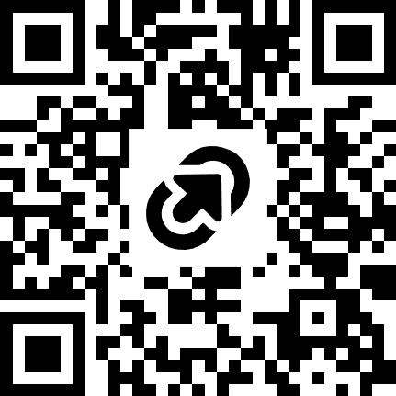
Feedback Time
https://tinyurl.com/bdf3ya92

